Slide 1
Données pour DR IAM: SETTAT - AVANZIT + EM Telecom (partiel)
Lignes: 19 | ST FO: AVANZIT + EM Telecom (partiel)

Slide 2
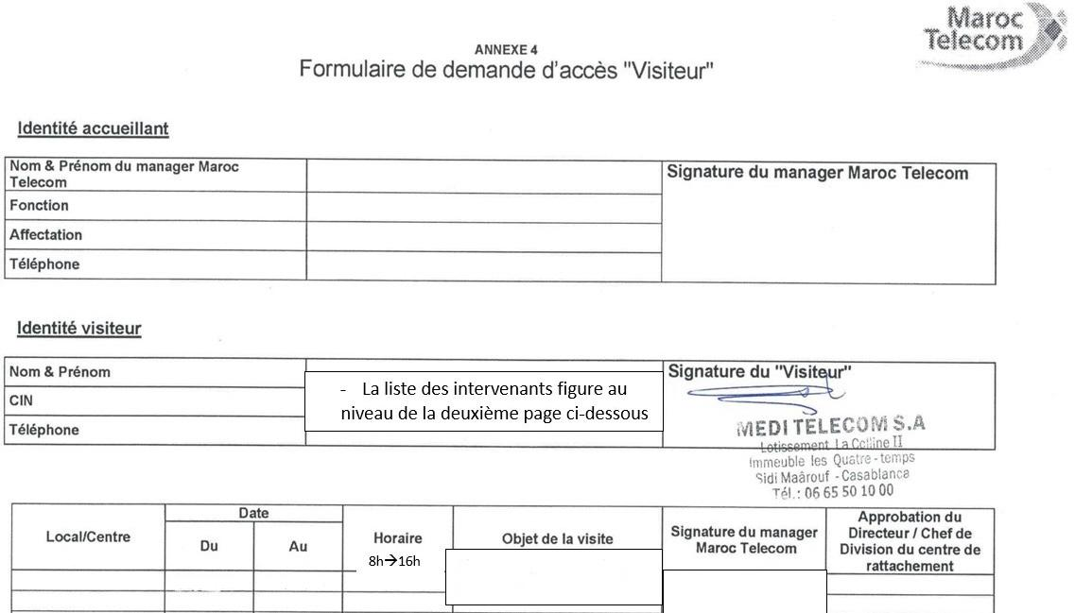
code site | ST FO | contact ERPT | DR IAM | ville | X Départ ERPT - Y Départ ERPT | X Arrivée ERPT Proposition1 - Y Arrivée
SET944 | AVANZIT | 0660127763 AZEDDINE | SETTAT | Berrechid | 33.2569,-7.583056 | 33.252764,-7.587401
SET933 | AVANZIT | 0660127763 AZEDDINE | SETTAT | Berrechid | 33.26375,-7.6068611 | 33.2640533,-7.5920529
SET1046 | AVANZIT | 0660127763 AZEDDINE | SETTAT | Berrechid | 33.256667,-7.578611 | 33.265154,-7.583191
SET955 | AVANZIT | 0660127763 AZEDDINE | SETTAT | Berrechid | 33.253762,-7.572235 | 33.265154,-7.583191
SET1041 | AVANZIT | 0660127763 AZEDDINE | SETTAT | Berrechid | 33.2593056,-7.5613611 | 33.265632,-7.573936
SET1019 | AVANZIT | 0660127763 AZEDDINE | SETTAT | Berrechid | 33.27126,-7.569437 | 33.269592,-7.574320
SET1077 | AVANZIT | 0660127763 AZEDDINE | SETTAT | Berrechid | 33.2713899,-7.576944 | 33.269592,-7.574320
SET1040 | AVANZIT | 0660127763 AZEDDINE | SETTAT | Berrechid | 33.2723611,-7.5899444 | 33.2749657,-7.5873898
SET927 | AVANZIT | 0660127763 AZEDDINE | SETTAT | Berrechid | 33.2747,-7.57994 | 33.2753538,-7.5824337
SET1083 | AVANZIT | 0660127763 AZEDDINE | SETTAT | Berrechid | 33.257557,-7.574655 | 33.265154,-7.583191
SET952 | AVANZIT | 0660127763 AZEDDINE | SETTAT | Berrechid | 33.276483,-7.569256 | 33.277742,-7.580344
SET1023 | AVANZIT | 0660127763 AZEDDINE | SETTAT | Berrechid | 33.2809722,-7.5699444 | 33.277742,-7.580344
KBG699 | EM Telecom | 0660127763 AZEDDINE | SETTAT | Béni Mellal | -6.36969399999999997, 32.34583299999999895 | 32.34207607, -6.36866034
KBG102 | EM Telecom | 0660127763 AZEDDINE | SETTAT | Béni Mellal | -6.33868999999999971, 32.33870000000000289 | 32.34690000, -6.34261000
KBG727 | EM Telecom | 0660127763 AZEDDINE | SETTAT | Béni Mellal | -6.34027799999999964, 32.33163900000000268 | 32.33523649, -6.35339367
KBG648 | EM Telecom | 0660127763 AZEDDINE | SETTAT | Béni Mellal | -6.34783320000000018, 32.33461100000000243 | 32.33523649, -6.35339367
KBG702 | EM Telecom | 0660127763 AZEDDINE | SETTAT | Béni Mellal | -6.3520310000000002, 32.33227800000000229 | 32.33523649, -6.35339367
KBG101 | EM Telecom | 0660127763 AZEDDINE | SETTAT | Béni Mellal | -6.35435999999999979, 32.3282999999999987 | 32.33407876, -6.35881712
KBG623 | EM Telecom | 0660127763 AZEDDINE | SETTAT | Béni Mellal | -6.36033299999999979, 32.32333299999999809 | 32.32780000, -6.37292000

